Slide 1




What is (eco)metabolomics?
Ecometabolomics Training Course
icipe, Kasarani, Kenya
Oct 24, 2022

Slide 2
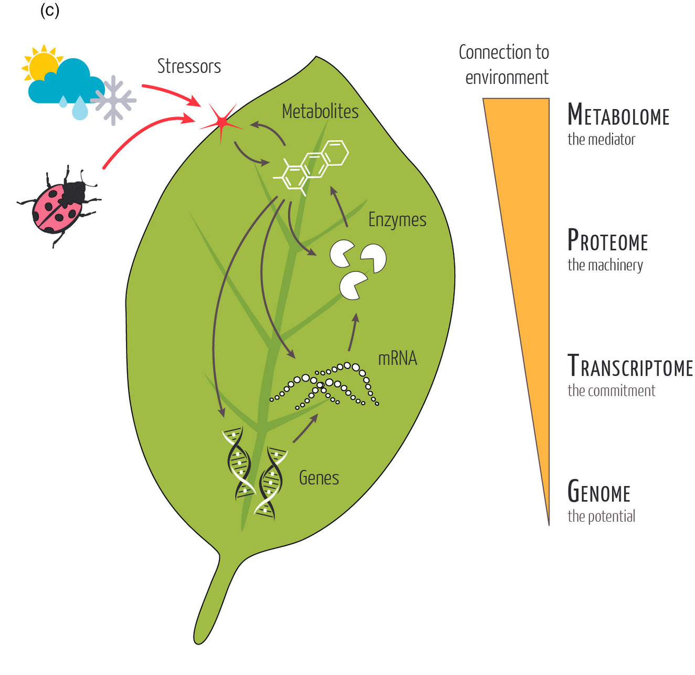
What is (eco)metabolomics?
eco + metabol + omics
Omics - Omics aims at the collective characterization and quantification of pools of biological molecules that translate into the structure, function, and dynamics of an organism or organisms.
Journal of Ecology, Volume: 110, Issue: 1, Pages: 4-20, First published: 12 January 2022, DOI: (10.1111/1365-2745.13826)

Slide 3
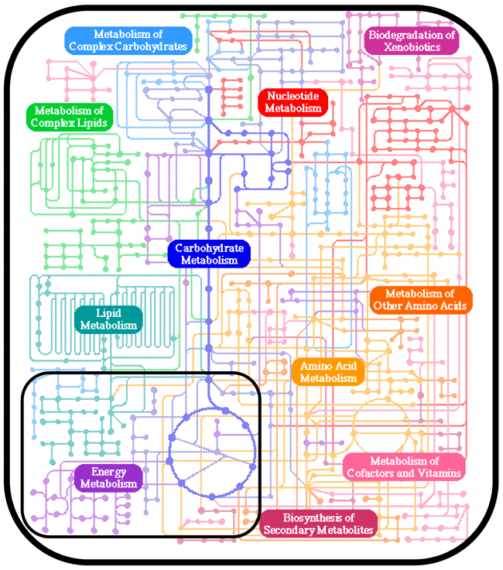
What is (eco)metabolomics?
eco + metabol + omics
Metabol = metabolism or metabolites. We are attempting to measure the chemical fingerprint of a sample
Composition – what metabolites present?
Quantity – how much of each is present?
Representation of the cellular metabolome. (Modified from the KEGG Pathway Database

Slide 4
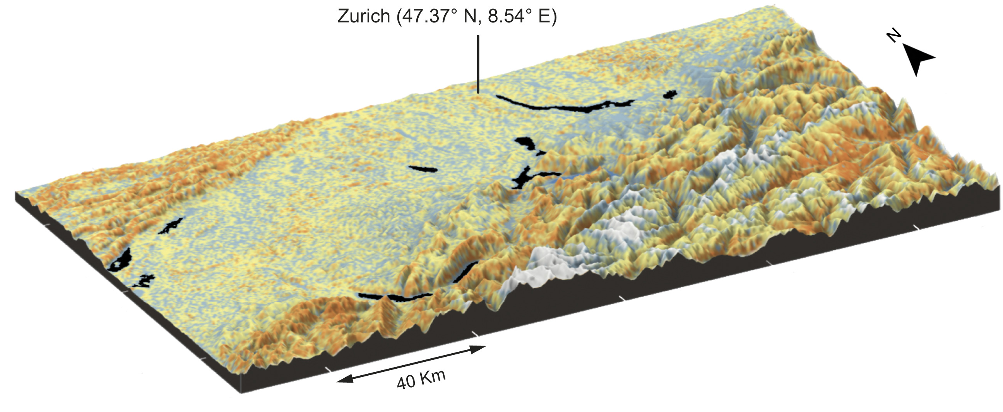
What is (eco)metabolomics?
eco + metabol + omics
Eco = ecology, and evolution – focus on understanding the influence of chemistry on ecological interactions or in shaping evolution.
(often) broad-scale – compares samples between species or across ecosystems
Phytochemical Diversity
Spatial and evolutionary predictability of phytochemical diversity
https://doi.org/10.1073/PNAS.2013344118

Slide 5
Ecometabolomics – measure chemical variation between samples to understand ecology and evolution
What is (eco)metabolomics?
eco + metabol + omics
How do we use ecometabolomics?

Slide 6
How do we use ecometabolomics?
What do we measure?
Often plants… but can be any biological sample…

Slide 7
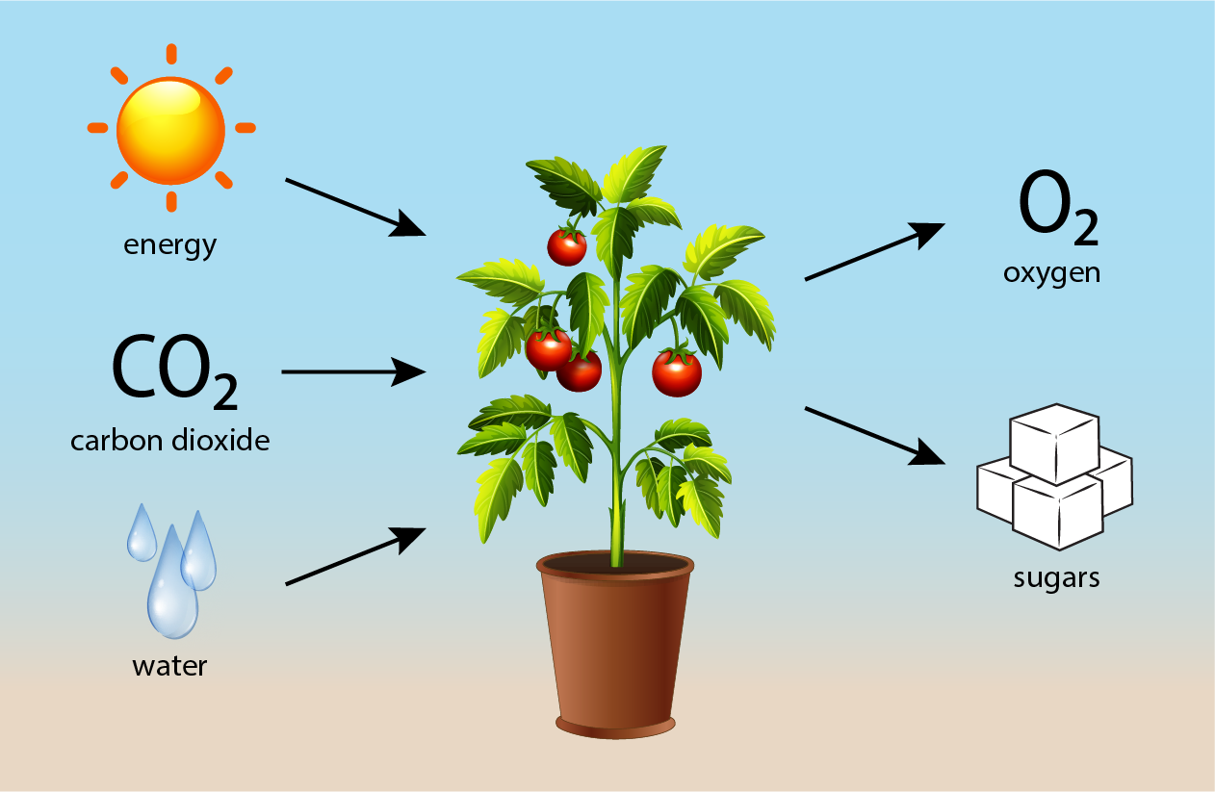
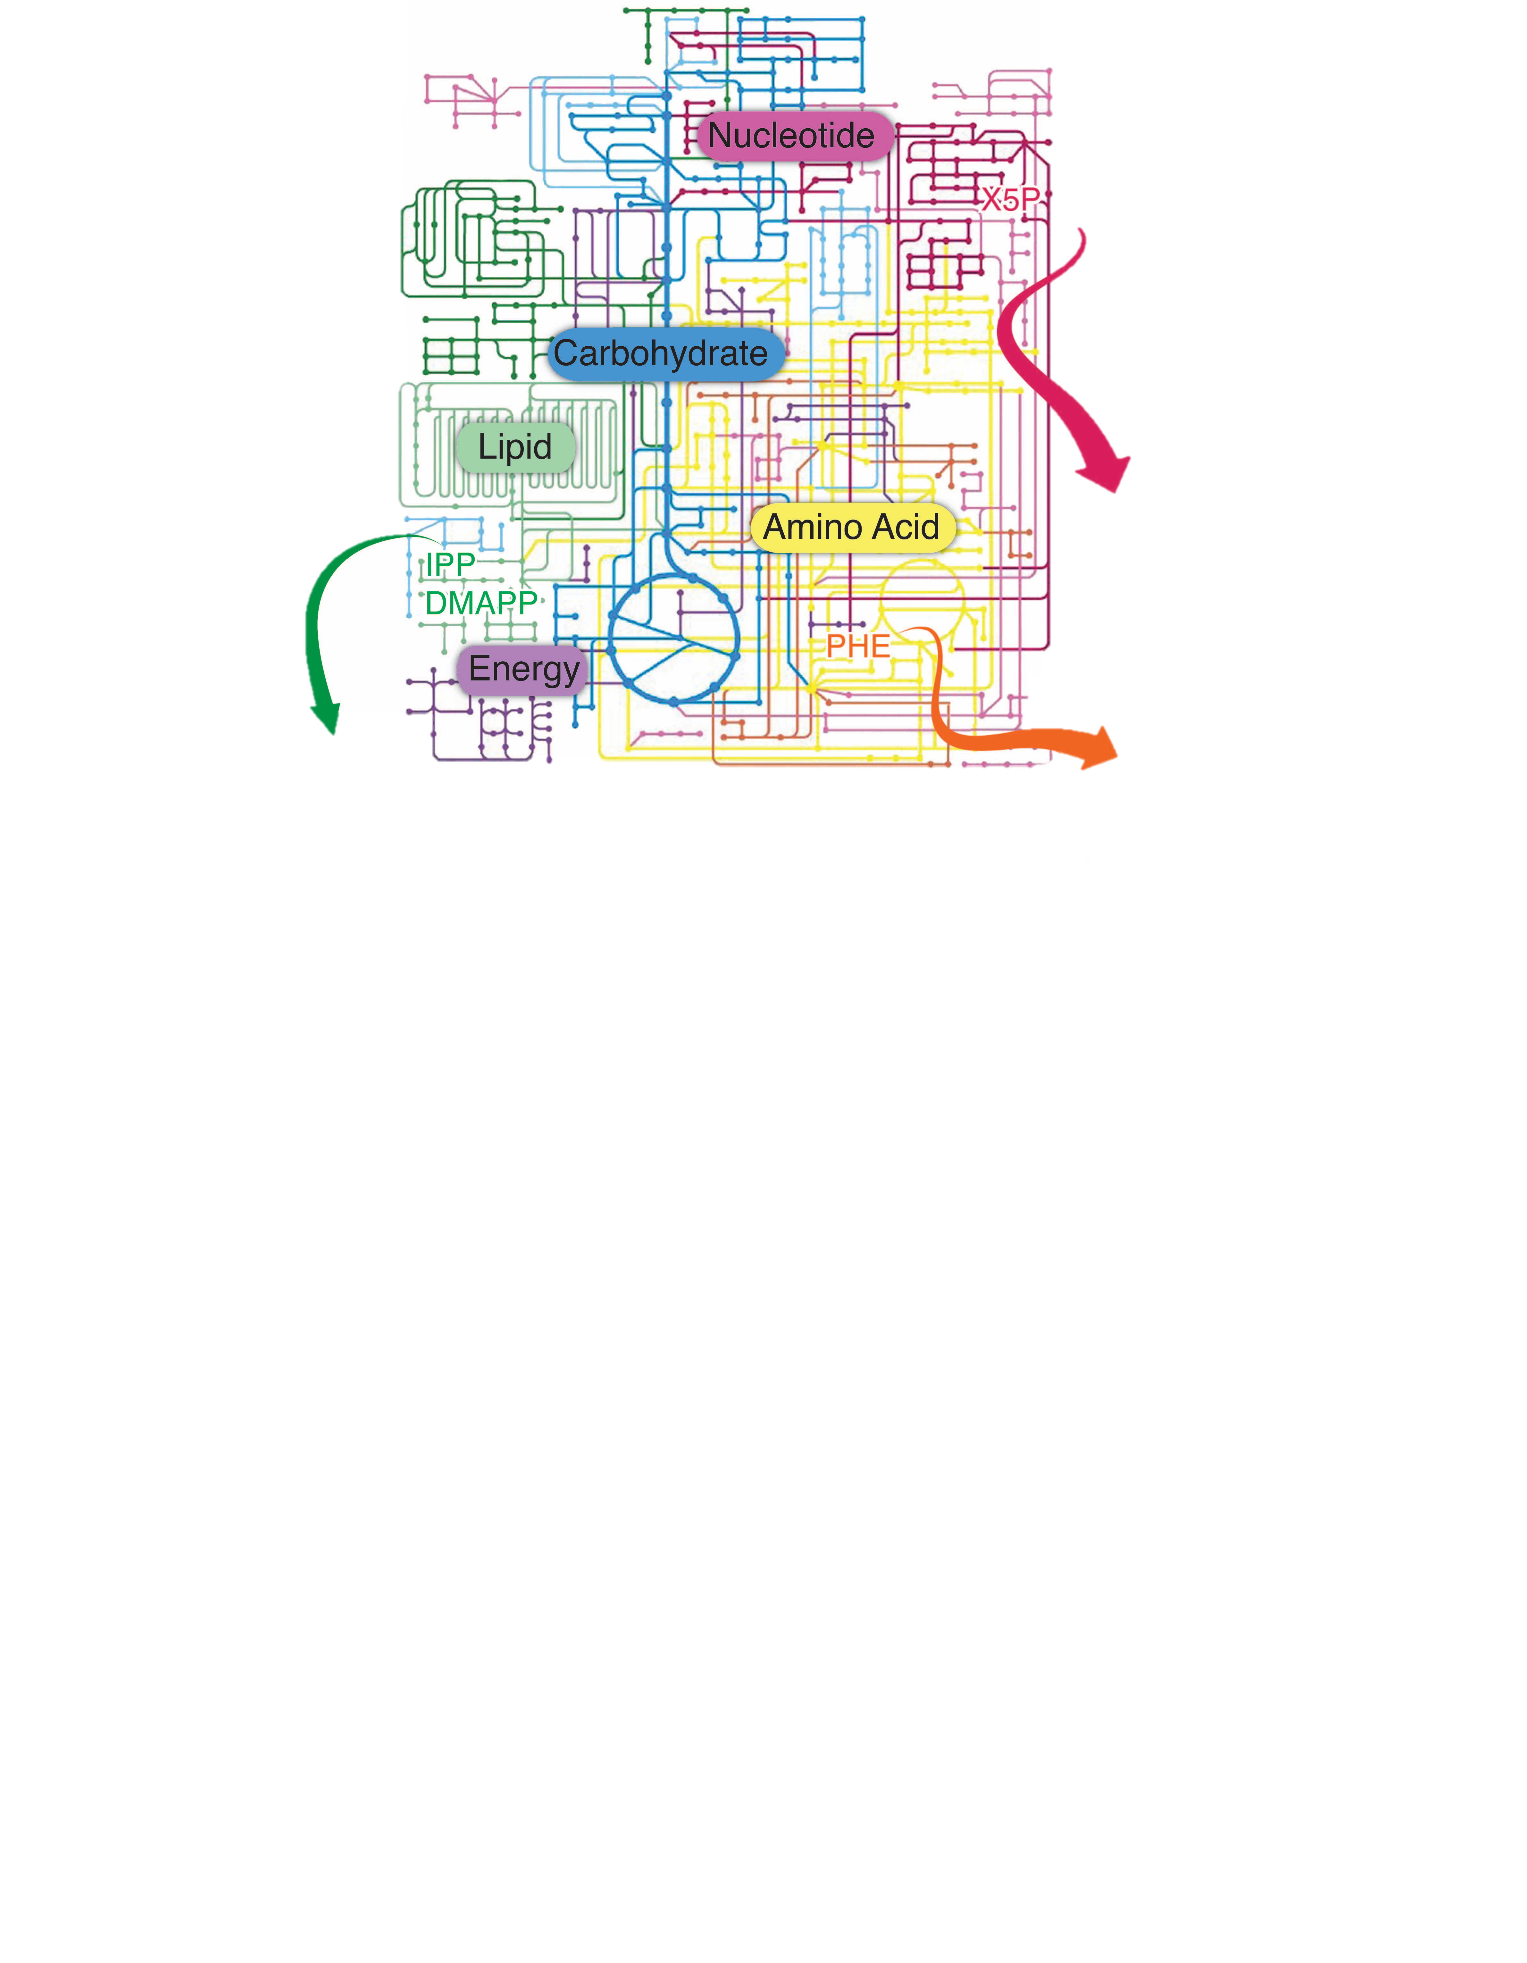
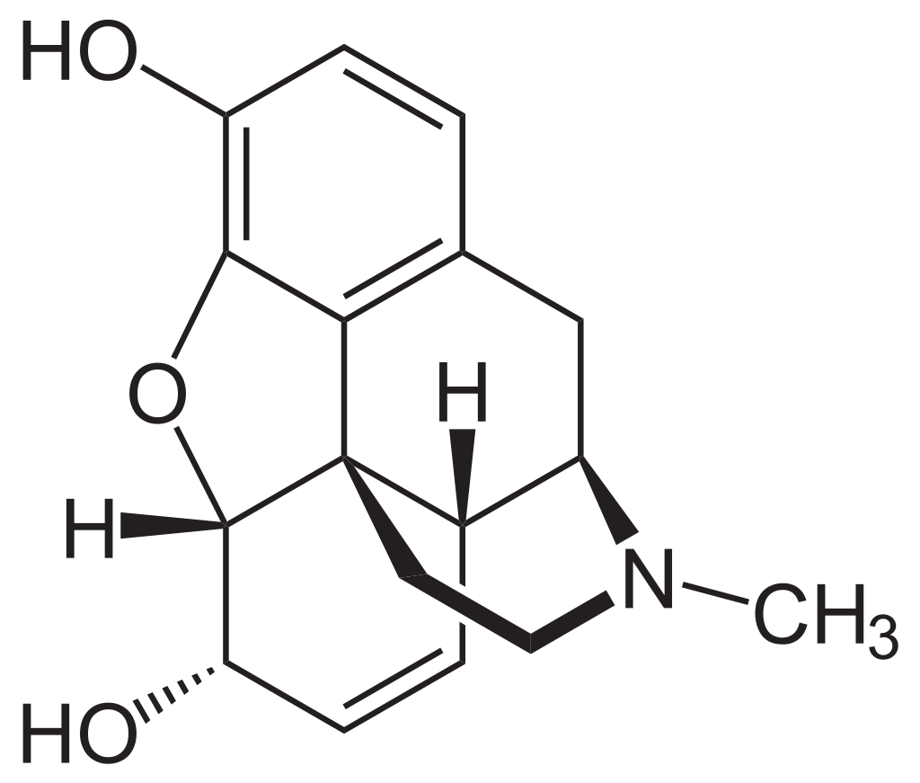
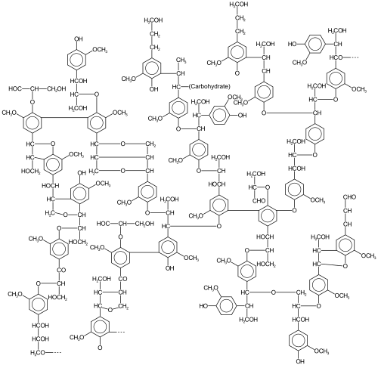
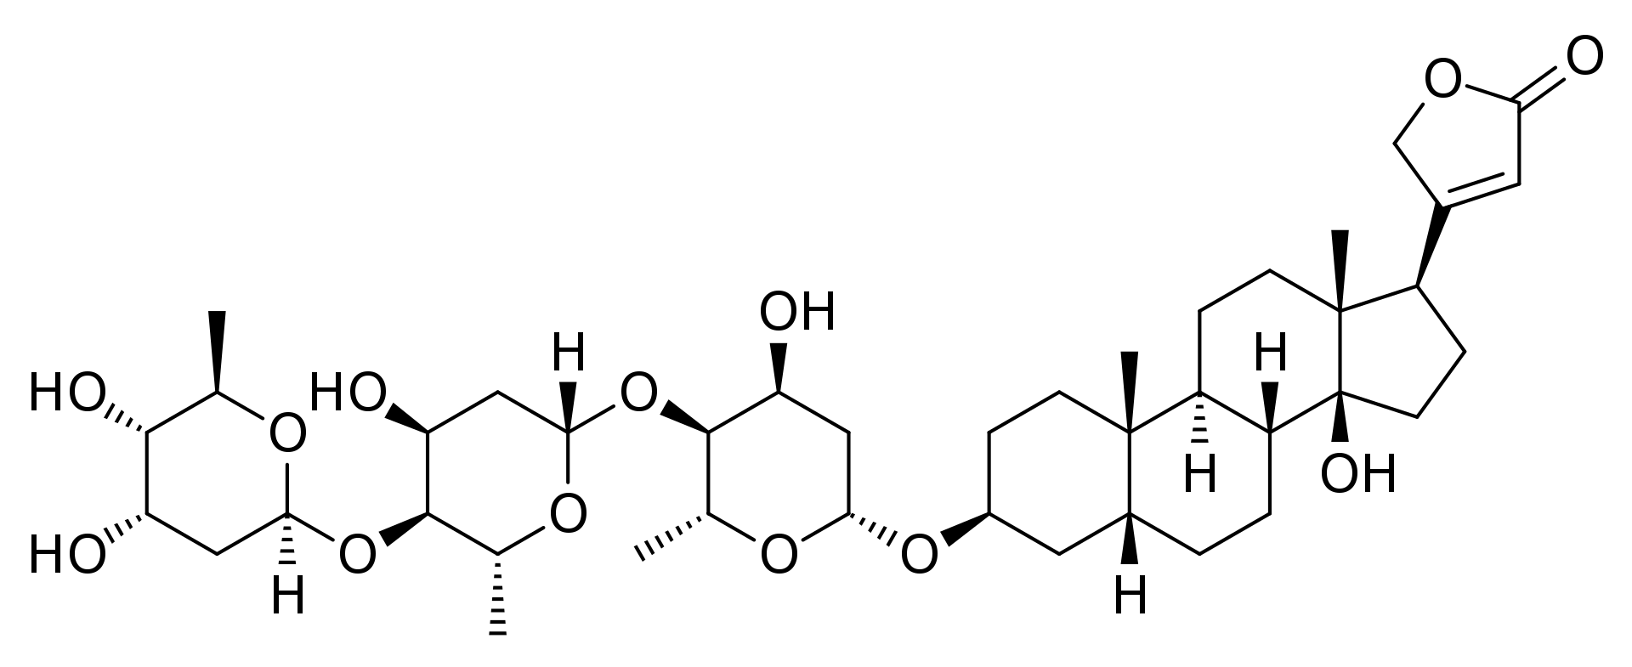
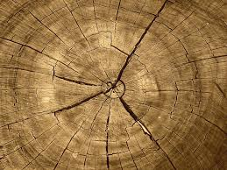
Plant Secondary Metabolism
caffeine
Primary Metabolism
morphine
Mediate ecological interactions (defense or mutualisms)
800,000 to 1,000,000 compounds across plant kingdom
Up to 50% of leaf dry weight
lignin
Digitoxin
Notes:
But this depiction of photosynthesis is far too simple. The metabolic prowess of plants does not stop with the conversion of co2 into sugar molecules. Photosynthetic carbon is converted into hundres of primary metabolites, which are essential for cellular functioning, and as well as a huge diversity of secondary metabolites, which are adaptive but nonessential.
Secondary metabolites, serve many purposes like lignan which provide structural support for upward growth, but they largely are used to mediate ecological interactions. Many compounds are toxic to pests and pathogens, and some even serve to attract mutualists and pollinators.
As sessile organisms, plants rely on this metabolic diversity for nearly all aspects of their lives with nearly 1,000,000 unique plant compounds predicted to exist across the plant kingdom.
Plants invenst heavily in secondary metabolism, with some leaves containing mre than 50% dry weight in secondary metabolites.

Slide 8
How do we use ecometabolomics?
At what scale do we measure?
Notes:
In my dissertation I used these techniques to quantify how plant chemistry changes at small to large spatial and temporal scales. Starting with comparing parts of an individual plant,

Slide 9
How do we use ecometabolomics?
How do we measure chemical variation?
Notes:
In my dissertation I used these techniques to quantify how plant chemistry changes at small to large spatial and temporal scales. Starting with comparing parts of an individual plant,

Slide 10
Key steps in ecometabolomics
Notes:
In my dissertation I used these techniques to quantify how plant chemistry changes at small to large spatial and temporal scales. Starting with comparing parts of an individual plant,

Slide 11
Targeted vs Untargeted

Slide 12
The ecometabolomics workflow

Slide 13
What we will cover in this workshop
Oct 24th
Deep dive into the ecometabolomics workflow
Intro to R and check that everyone has necessary software!
Oct 25th

Slide 15
A deep dive into the ecometabolomics workflow
Ecometabolomics Training Course
icipe, Kasarani, Kenya
Oct 24, 2022

Slide 16
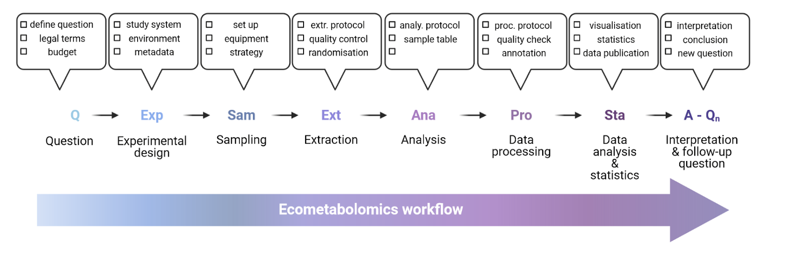

Slide 23
Using MS/MS in ecometabolomics
Ecometabolomics Training Course
icipe, Kasarani, Kenya
Oct 24, 2022

